Slide 1
The results and evaluation of the interview and documentation of Voices of Tohoku after the Earthquake 2011 Takehiko Ito ( Wako University, Tokyo) Poster presentation in ICP2016 p.207 07/28 09:30-10:30 PS28A-06-296

Slide 2
Previous Study Posttraumatic growth (PTG) of children in Tohoku after the earthquake 2011 ● Ito, T., & Iijima, Y.(2013). Posttraumatic growth in essays by children affected by the March 11 Earthquake Disaster in Japan: A text mining study. Journal of International Society of Life Information Science, 31(1), 67-72.

Slide 3
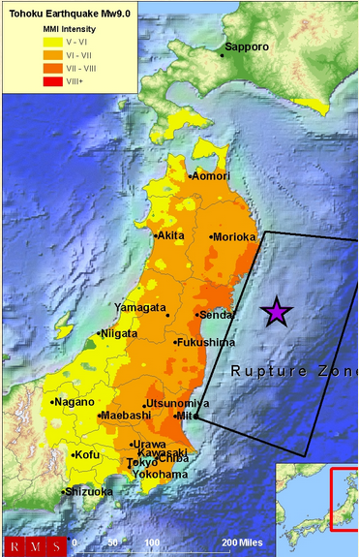

Slide 4
“Voices of Tohoku” (VOT) based on Life Story Interview and community documentation and archive.
The life-story interview is the methodological basis of JISP “Voices of Tohoku” project.
Drawing on narrative psychology and oral history, “life-story” is a dutiful interviewing technique.
It was extensively employed by Prof. Amia Lieblich, a renowned scholar, who also serves as the mentor of this unique archiving project.

Slide 5
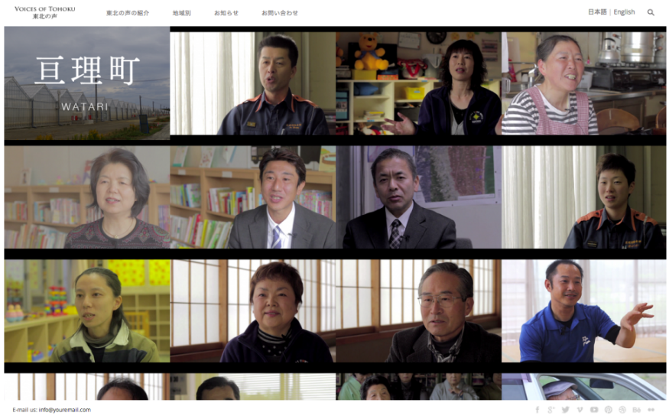
Life story interview: Historical aspects. (Lieblich, Amia. 2014)
The historical aspect of life stories equates with the collective story that emerges from the individuals accounts.
In their rich differences, human touch, warmth, and empathy individuals stories enable a collective oral history.
Lieblich, A. (2014). The contribution of narrative approach to posttraumatic growth
Paper presented at Wako University いとうたけひこ・山崎和佳子（訳 2015）
心的外傷後成長(PTG）研究におけるナラティブ・アプローチ: 苦労体験学
（Suffering Experience Research）に向けて 東西南北2015：和光大学総合文化研究所年報,
104-116.

Slide 6
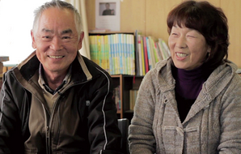
Life story interview: Psychological aspects (1).
(1) individuals tell their story to heal. Previous studies in Japan have shown that victims are particularly able to improve their mental state by sharing their troubles and hardships with others. In this context, “life story” provides individuals with the opportunity to share their story.
By telling it, survivors and supporters alike create a “distance” between themselves and the past, and reflect on their experience through new lens.

Slide 7
Life story interview: Psychological aspects (2).
(2) individuals tell their story to commemorate.
In order to preserve the memories of individuals who died and communities that do not exist anymore, individuals give “testimonies” of lives as they knew it.
Often in this process, interviewees gain insights into their future.

Slide 8
Five Factors of Posttraumatic Growth
Factor 1: “Relating to Others”
Factor 2: “New Possibilities”
Factor 3: “Personal Strength”
Factor 4: “Spiritual Change”
Factor 5: “Appreciation of Life”
Tedeschi R. G., & Calhoun, L. G. (1996). The Posttraumatic Growth Inventory: Measuring the positive legacy of trauma. Journal of Traumatic Stress, 9, 455-451.

Slide 9
Factor 1: “Relating to Others”
By broadcasting local radio, there are support from other towns. Furthermore, I realize heartful and wonderful work done by local people. (Female)
●第1因子「他者との関係にまつわる人間としての成長」 ・地域の人、外部支援者
・「放送していて、他の町から支援していただけるのも大きな成果でしたけれども、町の中の人がこんなにこんなに心のあたたかい、そして素敵な仕事をしているというのが初めて分かったんです」
（女性、 亘理町）

Slide 10
Factor 2: “New Possibilities”
Lots of things are lost at a time, including human life. Therefore, I have thought, if I have something I can do now, I should try to do it, especially that will help somebody. (Female)
●第２因子「新たな可能性」・・・地域貢献、自分の能力
・「多くの物は一瞬で失われる。人の命も一瞬で失われる。だから今自分に出来ることがあったら、それはやってみるべきだし、そのことでなにか一つでも誰かのためになるなら、取り組んでみるべきだ、って思うようになりましたね」（女性、亘理町）

Slide 11
Factor 3: “Personal Strength”
When I confront difficulties, I should cope with them remembering the scene. I have had precious experience since then. (Male)
●第３因子「人間としての強さ」・・・試練に立ち向かう、忍耐、弱点の受容
「だから少々の困難にあっても、あの場面を頭にスッと描けば、なんでも耐えていかなければなと。こんな思いで、ほんとに貴重な貴重な体験。これをさせて頂きました。」 （男性、亘理町）

Slide 12
Factor 4: “Spiritual Change”
I want to preserve this abundant nature and ancestors’ wisdom, which are rich in Japan. Each region has its own charm. I am fascinated by the scenery and local people, so I would like to continue to preserve those treasures.
●第4因子「精神性的(スピリチュアルな)変容」・・自然・命・神秘
「残していきたいのはやっぱりこの豊かな自然と、先人の知恵ですね。それが日本の良さじゃないかなと思っていますので。それぞれの地域の魅力があるんですよね、そこの風景と、そこにいる人の魅力だと思いますので、そういうのを残していけたら良いかなと思います」（男性、石巻市）

Slide 13
Factor 5: “Appreciation of Life”
I am grateful to make use of my experiences for broadcasting: those experience of housewife raring children for ten years. (Female)
I am lucky to be born in Japan, since various people helped me. (Male)
第５因子「人生に対する感謝」・・・人生への感謝
他者への感謝
「震災前ずっと主婦をしていて、10年間子育てをしていたということが放送に活かせて、本当に良かったと思っています。」（女性、亘理町）
「これはもう日本に生まれて本当に良かったなと思います。っていうのは本当にいろんな人が援助してくれるんですよ。」（男性、山元町）

Slide 14
References
● Ito, T. (2014). Effects of tsunami and nuclear disaster on children’s time perspective: A text mining study of essays after the Great East Japan Earthquake. Journal of International Society of Life Information Science, 32(1), 44-46.
● Ito, T. (2015) What kind of media contributes to human happiness?: From 9/11 in New York to 3/11 in Fukushima. Journal of International Society of Life Information Science,
● Ito, T. & Goldstein, K. (2015). Tohoku stories: Identifying happy themes of disaster relief. Journal of International Society of Life Information Science, 33(1), 70-75.
● Ito, T., & Iijima, Y.(2013). Posttraumatic growth in essays by children affected by the March 11 Earthquake Disaster in Japan: A text mining study. Journal of International Society of Life Information Science, 31(1), 67-72.
● Ozaki, M. (2012). Pojitibu Shinrigaku Saikou (Rethinking Positive Psychology). Nakanishiya Publisher
● Taku, K., Calhoun, L. G., Tedeschi, R. G., Gil-Rivas, V., Kilmer, R. P., & Cann, A. (2007). Examining posttraumatic growth among Japanese university students. Anxiety, Stress, & Coping, 20, 353-367.
● Tedeschi R. G., & Calhoun, L. G. (1996). The Posttraumatic Growth Inventory: Measuring the positive legacy of trauma. Journal of Traumatic Stress, 9, 455-451.

Slide 15
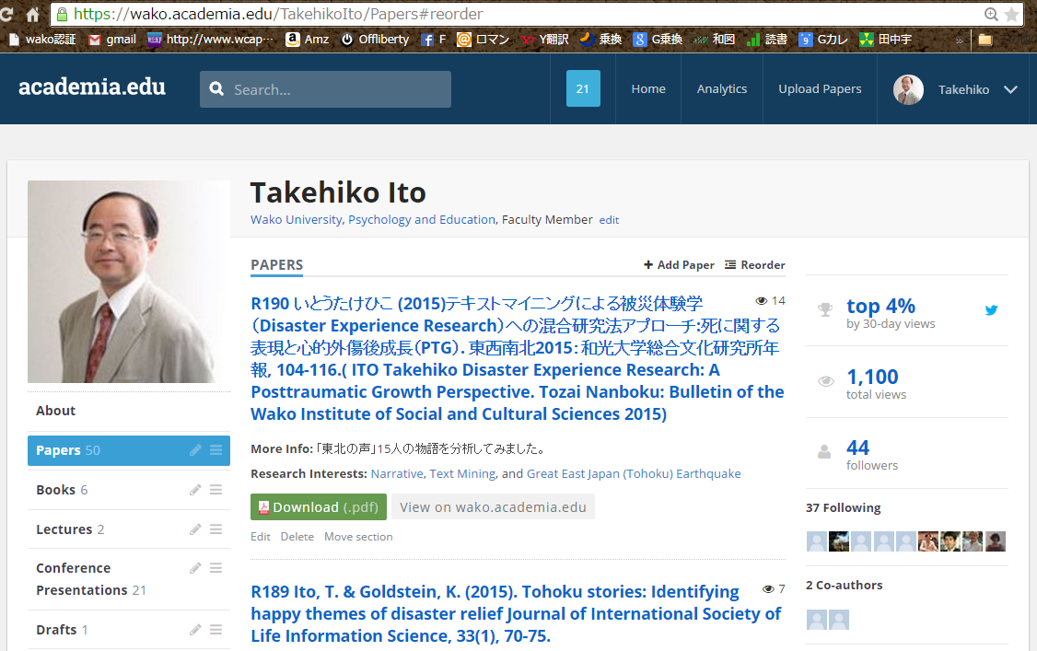
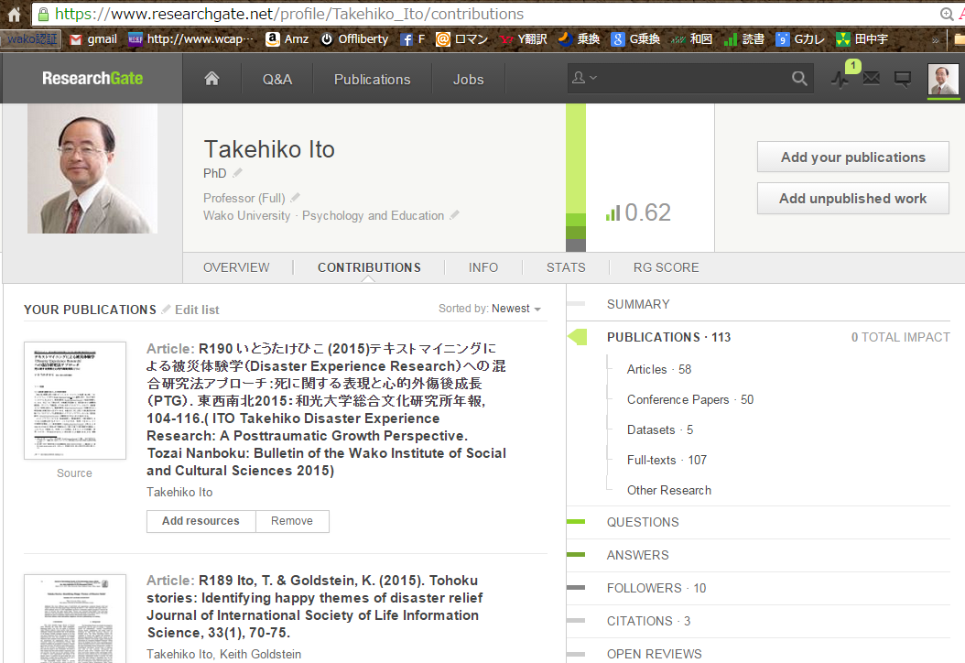
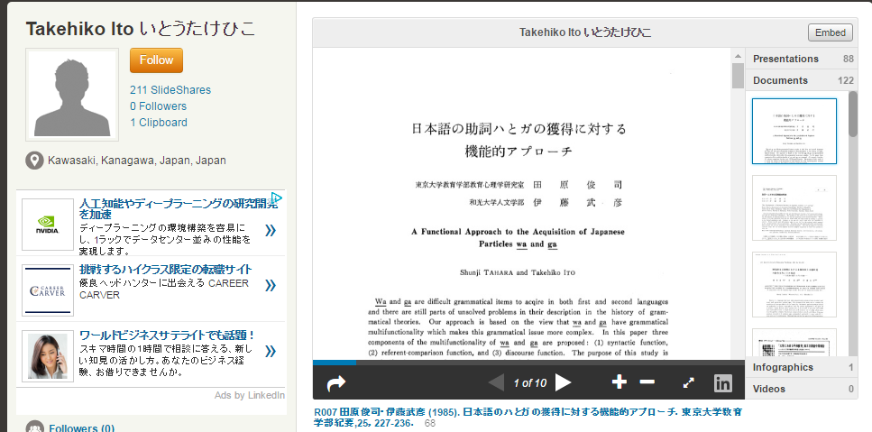
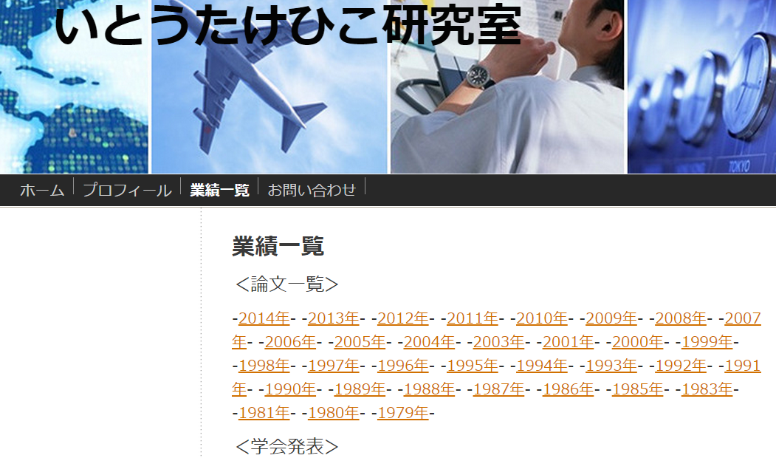
You can download my papers from
academia.edu
researchgate.net
itotakehiko.com
slideshare.net

Slide 16
